Slide 1

Kale Group of Industries
Quality Culture. Global Future.

Slide 2



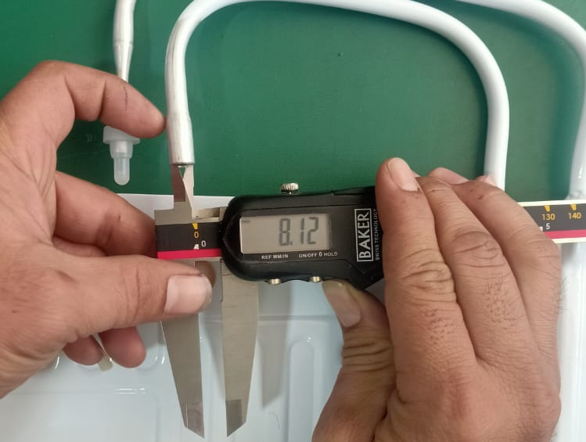
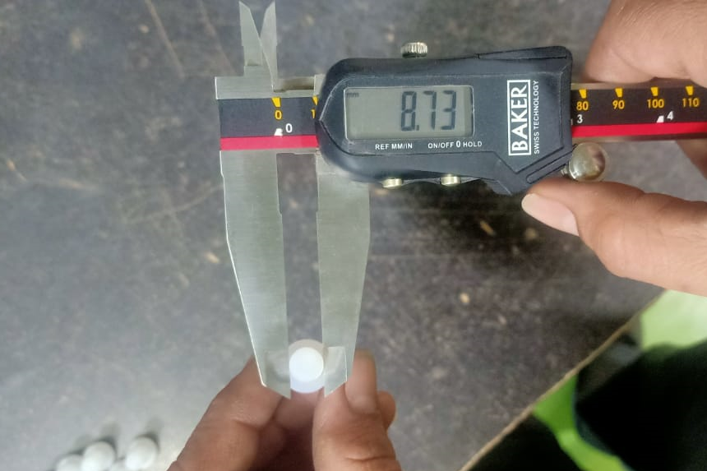
INSPECTION OF SUCTION & CAP DIMENSION CHECKS-
Sr. No. | Suction Joint ID (8.20 +0.1/-0.00 mm) | Suction Cap OD (9.00 +/- 0.2 mm)
 | Observations
1 | 8.13 | 8.76
2 | 8.16 | 8.73
3 | 8.14 | 8.73
4 | 8.12 | 8.67
5 | 8.12 | 8.77
6 | 8.17 | 8.71
7 | 8.11 | 8.83
8 | 8.15 | 8.69
9 | 8.15 | 8.74
10 | 8.14 | 8.73
Min | 8.11 | 8.67
Max | 8.17 | 8.83
Suction Joint ID
Suction Cap OD

Slide 3
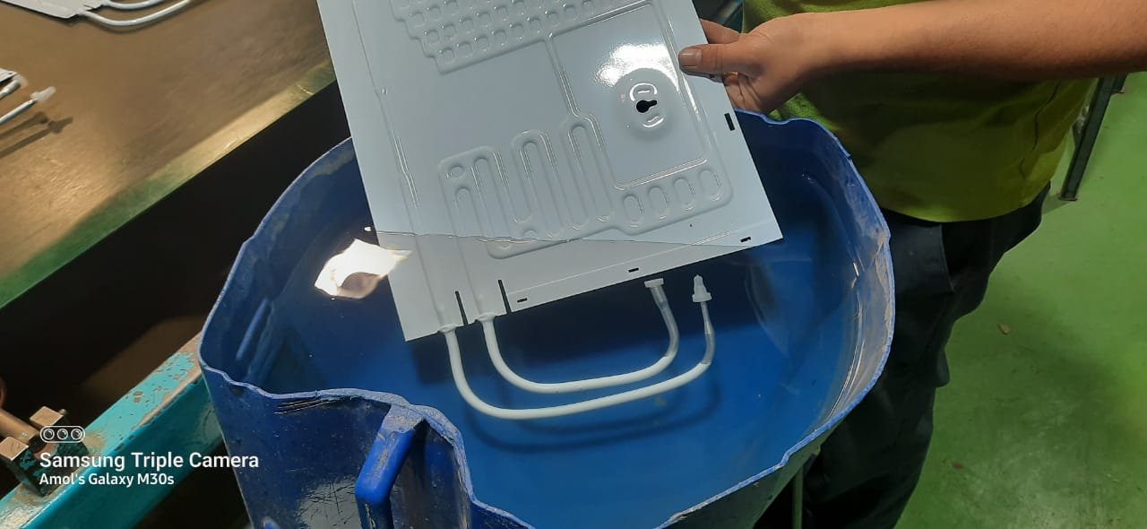
CAP LEAK TEST INSPECTION -
Daily Production Vs Cap Leak Data-
Sr No | Date | Production Qty | Cap Cut / Cap Leak | % Cap Cut / Cap Leak
1 | 21-09-23 | 72 | 0 | 0.00
2 | 25-09-23 | 151 | 1 | 0.66
3 | 27-09-23 | 48 | 0 | 0.00
4 | 13-12-23 | 684 | 0 | 0.00
5 | 14-12-23 | 1116 | 2 | 0.18
6 | 18-12-23 | 396 | 0 | 0.00
7 | 12-01-24 | 2112 | 1 | 0.05
8 | 13-01-24 | 160 | 0 | 0.00
9 | 16-01-24 | 1408 | 1 | 0.07
10 | 24-01-24 | 416 | 0 | 0.00
11 | 25-01-24 | 96 | 0 | 0.00
12 | 30-01-24 | 1600 | 2 | 0.13
13 | 31-01-24 | 1984 | 3 | 0.15
14 | 01-02-24 | 222 | 1 | 0.45
15 | 08-02-24 | 3360 | 3 | 0.09
16 | 10-02-24 | 96 | 0 | 0.00
17 | 12-02-24 | 96 | 0 | 0.00
18 | 27-02-24 | 32 | 0 | 0.00
Total |  | 14049 | 14 | 0.10
Cap Leak Test –
Acceptance criteria :- No air bubble formation

Slide 4
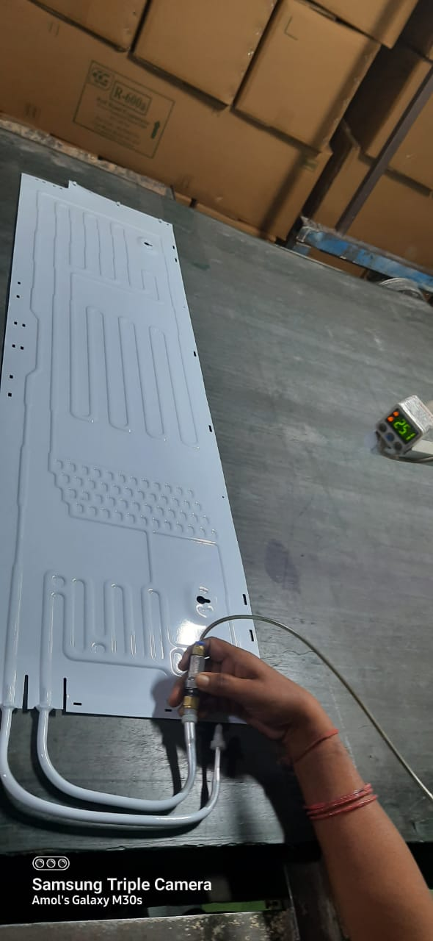
NITROGEN PRESSURE INSPECTION -
Daily N2 Pressure Insp. Data-after 24 hrs
Sr. No. | Date | Lot Qty. | Defects |  | Total Rej | Root causes |  |  | Total Rej qty | % of Rej | Remark if any
 |  |  | < 10 Psi | (Zero )" 0" N2 |  | Cap Missing | Joint Leakage / Tig leak | Other
1 | 11.01.2024 | 852 | 3 | 3 | 6 | 2 | 0 | 4 | 6 | 0.70 | All these negative N2 Pressure Roll bond get rechecked through leak test
2 | 12.01.2024 | 175 | 0 | 1 | 1 | 1 | 0 | 0 | 1 | 0.57
3 | 15.01.2024 | 2426 | 8 | 3 | 11 | 4 | 0 | 7 | 11 | 0.45
4 | 17.01.2024 | 1878 | 5 | 1 | 6 | 2 | 0 | 4 | 6 | 0.32
5 | 31.01.2024 | 1718 | 6 | 3 | 9 | 3 | 0 | 6 | 9 | 0.38
6 | 01.02.2024 | 2392 | 6 | 4 | 10 | 4 | 0 | 6 | 10 | 2.04
7 | 02.02.2024 | 490 | 3 | 1 | 4 | 1 | 0 | 3 | 4 | 0.82
8 | 09.02.2024 | 2176 | 6 | 2 | 8 | 2 | 0 | 6 | 8 | 0.56
9 | 10.02.2024 | 1438 | 5 | 4 | 9 | 3 | 0 | 6 | 9 | #DIV/0!
10 |  |  |  |  | 0 |  |  | 0 | 0 | #DIV/0!
11 |  |  |  |  | 0 |  |  | 0 | 0 | #DIV/0!
12 |  |  |  |  | 0 |  |  | 0 | 0 | #DIV/0!
Total |  | 13545 | 42 | 22 | 64 | 20 | 0 | 42 | 64 | 0.47
 |  |  | Total Rej % - 0.47% |  | PPM - 4725
Nitrogen Pressure inspection after 24 hrs. of N2 purged
Acceptance criteria :- Min 10 PSI N2 pressure must be Present

